Slide 1
Web Systems and Algorithms
Unit 4
Clustering : Grouping Things Together

Slide 2
Machine Learning
Machine learning is an application of artificial intelligence (AI) that provides systems the ability to automatically learn and improve from experience without being explicitly programmed
Machine learning focuses on the development of computer programs that can access data and use it to learn for themselves

Slide 3
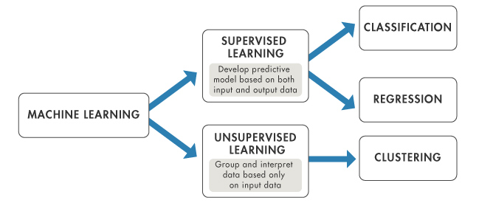
Machine Learning (Approaches)
Supervised Learning
Unsupervised Learning

Slide 4
Cluster Analysis
Cluster: a collection of data objects
Similar to one another within the same cluster
Dissimilar to the objects in other clusters
Cluster analysis
Finding similarities between data according to the characteristics found in the data and grouping similar data objects into clusters
Unsupervised learning: no predefined classes

Slide 5
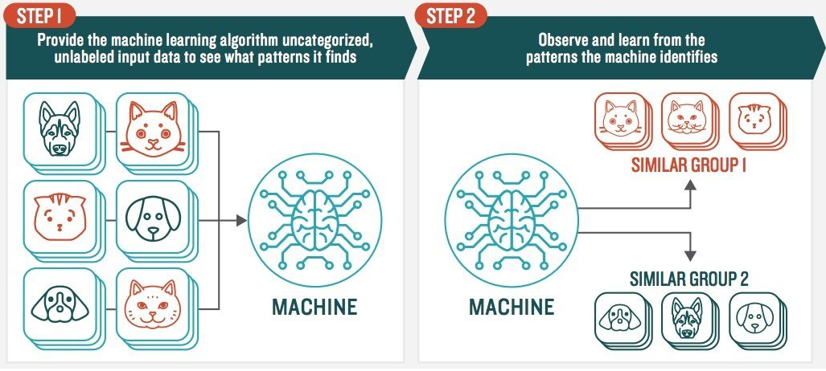
Unsupervised Learning

Slide 6
Clustering Techniques
Clustering techniques only.
Link Based
ROCK
Partitioning
k-Means algorithm
k-Medoids algorithm (PAM (Partitioning Around Medoids)
Hierarchical
Agglomerative and divisive algorithm
Density – Based
DBSCAN

Slide 7
k-Means Algorithm
k-Means clustering algorithm proposed by J. Hartigan and M. A. Wong [1979].
Given a set of n distinct objects, the k-Means clustering algorithm partitions the objects into k number of clusters such that intra-cluster similarity is high but the inter-cluster similarity is low.
In this algorithm, user has to specify k, the number of clusters and consider the objects are defined with numeric attributes and thus using any one of the distance metric to demarcate the clusters.

Slide 8
k-Means Algorithm…
Algorithm
Choose k number of clusters to be determined.
Choose k objects randomly as the initial cluster centers
Repeat
Assign each object to their closest cluster
Compute new clusters, calculate mean points
Until
No change in cluster entities OR
No objects change its clusters

Slide 9
k-Means Algorithm… (Example)
Instance | X | Y
1 | 1.0 | 1.5
2 | 1.0 | 4.5
3 | 2.0 | 1.5
4 | 2.0 | 3.5
5 | 3.0 | 2.5
6 | 3.0 | 4.0
If the objects are to be partitioned into 2 clusters then k = 2.
Next choose two points are random, object 1 and 3 are chosen,
i.e. C₁ = (1.0, 1.5) and C₂ = (2.0, 1.5)

Slide 10
Problems in k-Means
Weakness
Applicable only when mean is defined, then what about categorical data?
Need to specify k, the number of clusters, in advance
Unable to handle noisy data and outliers

Slide 11

k-Medoids
Minimize the sensitivity of k-means to outliers
Pick actual objects to represent clusters instead of mean values
Each remaining object is clustered with the representative object (Medoid) to which is the most similar
The algorithm minimizes the sum of the dissimilarities between each object and its corresponding reference point
E: the sum of absolute error for all objects in the data set
P: the data point in the space representing an object
O_{i}: is the representative object of cluster C_{i}

Slide 12
k-Medoids…
Initial representatives are chosen randomly
The iterative process of replacing representative objects by no representative objects continues as long as the quality of the clustering is improved
For each representative Object O
For each non-representative object R, swap O and R
Choose the configuration with the lowest cost

Slide 13
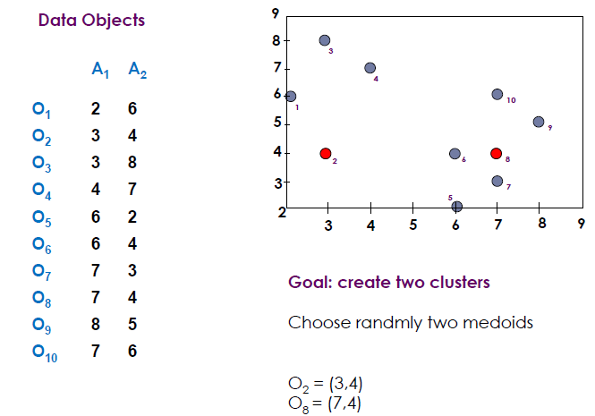
k-Medoids : Example

Slide 14
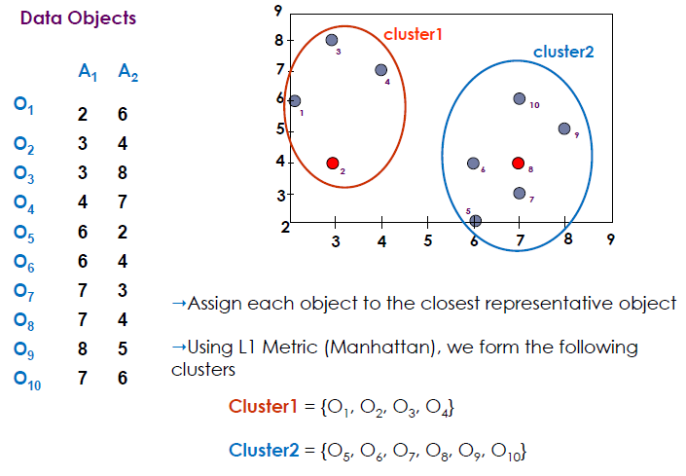
k-Medoids : Example…

Slide 15
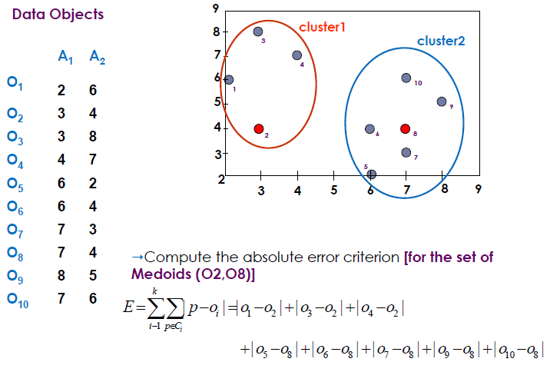
k-Medoids : Example…
Since 22>20 it is bad idea to
swap O₈ with O₇
Now let us swap O₇ with O₈
Error(O₂,O₇)=(3+4+4)+(2+2+1+3+3)=22
Error(O₂,O₈)=(3+4+4)+(3+1+1+2+2)=20

Slide 16
DBSCAN: Density Based Spatial Clustering of Applications with Noise
Two parameters:
Eps: Maximum radius of the neighbourhood
MinPts: Minimum number of points in an Eps-neighbourhood of that point
N_{Eps}(p): {q belongs to D | dist(p,q) <= Eps}
Directly density-reachable: A point p is directly density-reachable from a point q w.r.t. Eps, MinPts if
p belongs to N_{Eps}(q)
core point condition:
|N_{Eps} (q)| >= MinPts
p
MinPts = 5
Eps = 1 cm
q

Slide 17
Density-Reachable and Density-Connected
Density-reachable:
A point p is density-reachable from a point q w.r.t. Eps, MinPts if there is a chain of points p₁, …, p_{n}, p₁ = q, p_{n} = p such that p_{i+1} is directly density-reachable from p_{i}
Density-connected
A point p is density-connected to a point q w.r.t. Eps, MinPts if there is a point o such that both, p and q are density-reachable from o w.r.t. Eps and MinPts
p
p₁
q
p
q
o

Slide 18
DBSCAN…
Relies on a density-based notion of cluster: A cluster is defined as a maximal set of density-connected points
Discovers clusters of arbitrary shape in spatial databases with noise
Border point
< MinPts
∈Neighborhood
Outlier
Border
Eps = 1cm
MinPts = 5
Core

Slide 19
DBSCAN: The Algorithm
Arbitrary select a point p
Retrieve all points density-reachable from p w.r.t. Eps and MinPts.
If p is a core point, a cluster is formed.
If p is a border point, no points are density-reachable from p and DBSCAN visits the next point of the database.
Continue the process until all of the points have been processed.

Slide 20
DBSCAN: Example
D is Core Point
Consider the following distance matrix
 | A | B | C | D | E | F
A | 0 | 0.7 | 4.9 | 3.6 | 4.2 | 3.2
B | 0.7 | 0 | 5.7 | 2.9 | 3.5 | 2.5
C | 5.7 | 4.9 | 0 | 2.2 | 1.4 | 2.5
D | 3.6 | 2.9 | 2.2 | 0 | 1 | 0.5
E | 4.2 | 3.5 | 1.4 | 1 | 0 | 1.1
F | 3.2 | 2.5 | 2.5 | 0.5 | 1.1 | 0
Epsilon = 1.5, MinPts = 3
Now find the number of points whose
distance <=1.5
For A, (A,A) = 0, (A,B) = 0.7, are only <=1.5,
the number is 2 (<MinPts), so A is either
border point or noise
E is Core Point and similarly F is also core point
Now, we have to determine whether A, B, C are either Noise or Border point
For C, two distance <= 1.5 are 0(with C itself) and 1.4 (With E), and E is a core point,
so C is border point
But B and A are Noise

Slide 21
DBSCAN: Exercise
If epsilon = 2 and MinPts = 2, what are the clusters that DBSCAN would discover and also find the core points, border point and outliers from the following data set
A1(2,10), A2(2,5), A3(8,4), A4(5,8), A5(7,5), A6(6,4), A7(1,2), A8(4,9)
Two Clusters, C1 = {A4, A8}, C2 = {A3, A5, A6}
Outliers :- A1, A2, A7

Slide 22
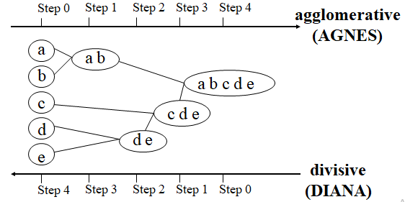
Hierarchical Clustering
Use distance matrix as clustering criteria. This method does not require the number of clusters k as an input, but needs a termination condition

Slide 23
Hierarchical Clustering…
Start with one cluster, individual item in its own cluster and iteratively merge clusters until all items belong to one cluster
Bottom up approach is followed to merge the clusters together
Dendograms are pictorially used to represent Hierarchical clustering

Slide 24
Hierarchical Clustering…
Hierarchical clustering is characterized by the development of a hierarchy or tree-like structure.
-Agglomerative clustering starts with each object in a separate cluster. Clusters are formed by grouping objects into bigger and bigger clusters.
-Divisive clustering starts with all the objects grouped in a single cluster. Clusters are divided or split until each object is in a separate cluster.
Agglomerative methods are commonly used in marketing research. They consist of linkage methods, variance methods, and centroid methods.

Slide 25
Hierarchical Clustering…
The single linkage method is based on minimum distance, or the nearest neighbor rule.
The complete linkage method is based on the maximum distance or the furthest neighbor approach.
The average linkage method the distance between two clusters is defined as the average of the distances between all pairs of objects

Slide 26
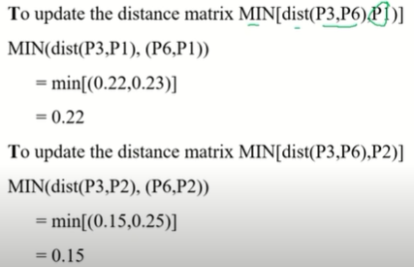
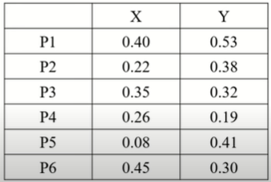
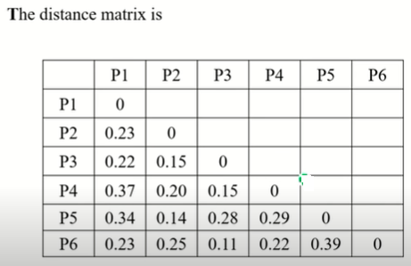
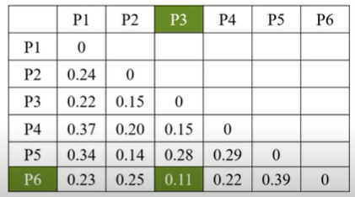

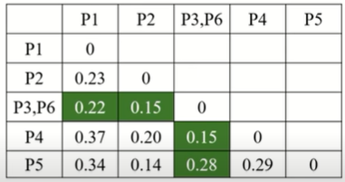
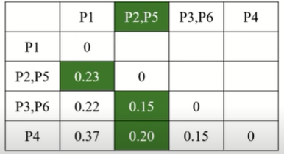
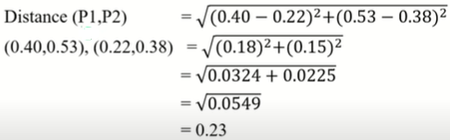
Hierarchical Clustering…
Example (Single Linkage)
Update matrix
Now matrix
Using Euclidean distance

Slide 27
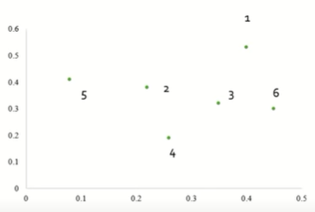
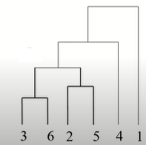


Hierarchical Clustering…
Example (Single Link)

Slide 28
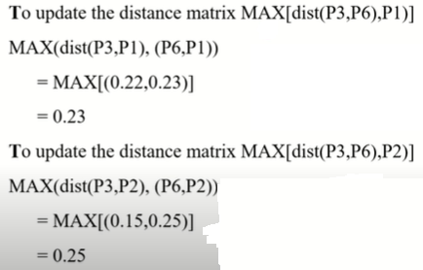
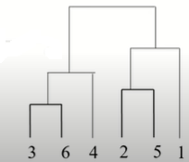
Hierarchical Clustering…
Example (Complete Link)

Slide 29
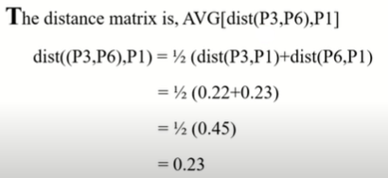
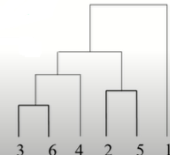
Hierarchical Clustering…
Example (Average Link)

Slide 30
ROCK (Robust Clustering using Links)
A Robust Clustering Algorithm for Categorical Attributes
Agglomerative hierarchical clustering algorithm that uses links
Neighbors and Links
Given the similarity between A and B {sim(A,B)}, and a threshold θ, then A and B are defined to be neighbors is sim(A,B) ≥ θ
Link (A,B) is the number of common neighbors between A and B
Having the larger link, more probable to be in same cluster
Use links between data, instead of distance

Slide 31

ROCK (Robust Clustering using Links)…
Where, n_{i} is the number of objects in cluster c_{i} and
f(θ) = (1- θ)/(1+ θ)
Computation of neighbors
Calculate the similarity matrix
Computation of Links
Using the similarity threshold θ, convert the similarity matrix into an adjacency matrix (A)
Then obtain a matrix indicating the number of links by calculating (A × A)
Computation of goodness to merge the cluster

Slide 32
ROCK (Example)
Consider the following documents
D1 = {judgment, faith, prayer, fair}
D2 = {fasting, faith, prayer}
D3 = {fair, fasting, faith}
D4 = {fasting, prayer, pilgrimage}
Similarity threshold = 0.3, and number of clusters = 2
Jaccard Coefficient (A, B) = (A ∩ B) / (A ∪ B)
Example:-
Sim(D1, D2) = 2 / 5 = 0.4

Slide 33
ROCK (Example)…
Now the similarity matrix will be
 | D1 | D2 | D3 | D4
D1 | 1 | 0.4 | 0.4 | 0.17
D2 | 0.4 | 1 | 0.5 | 0.5
D3 | 0.4 | 0.5 | 1 | 0.2
D4 | 0.17 | 0.5 | 0.2 | 1
 | D1 | D2 | D3 | D4
D1 | 1 | 1 | 1 | 0
D2 | 1 | 1 | 1 | 1
D3 | 1 | 1 | 1 | 0
D4 | 0 | 1 | 0 | 1
θ = 0.3
A (Adjacency
Matrix)
Pair | Goodness
D1,D2 | 1.35
D1,D3
D1,D4
D2,D3
D2,D4
D3,D4
Link Matrix (A×A)
 | D1 | D2 | D3 | D4
D1 |  | 3 | 3 | 1
D2 |  |  | 3 | 2
D3 |  |  |  | 1
D4
Goodness
measure

Slide 34
ROCK (Example)…
Pair | Goodness
D1,D2 | 1.35
D1,D3 | 1.35
D1,D4 | 0.45
D2,D3 | 1.35
D2,D4 | 0.90
D3,D4 | 0.45
 | D1 | D2 | D3 | D4
D1 |  | 3 | 3 | 1
D2 |  |  | 3 | 2
D3 |  |  |  | 1
D4
Now, update the link
matrix
 | D1,D2 | D3 | D4
D1,D2 |  | 3+3 | 1+2
D3 |  |  | 1
D4
Pair | Goodness
(D1,D2), D3
(D1,D2), D4
D3,D4
1.31
Goodness
Measure
0.66
0.45

Slide 35
ROCK (Example)…
D1 D2 D3 D4

Slide 36
End of Unit 4

